Slide 1

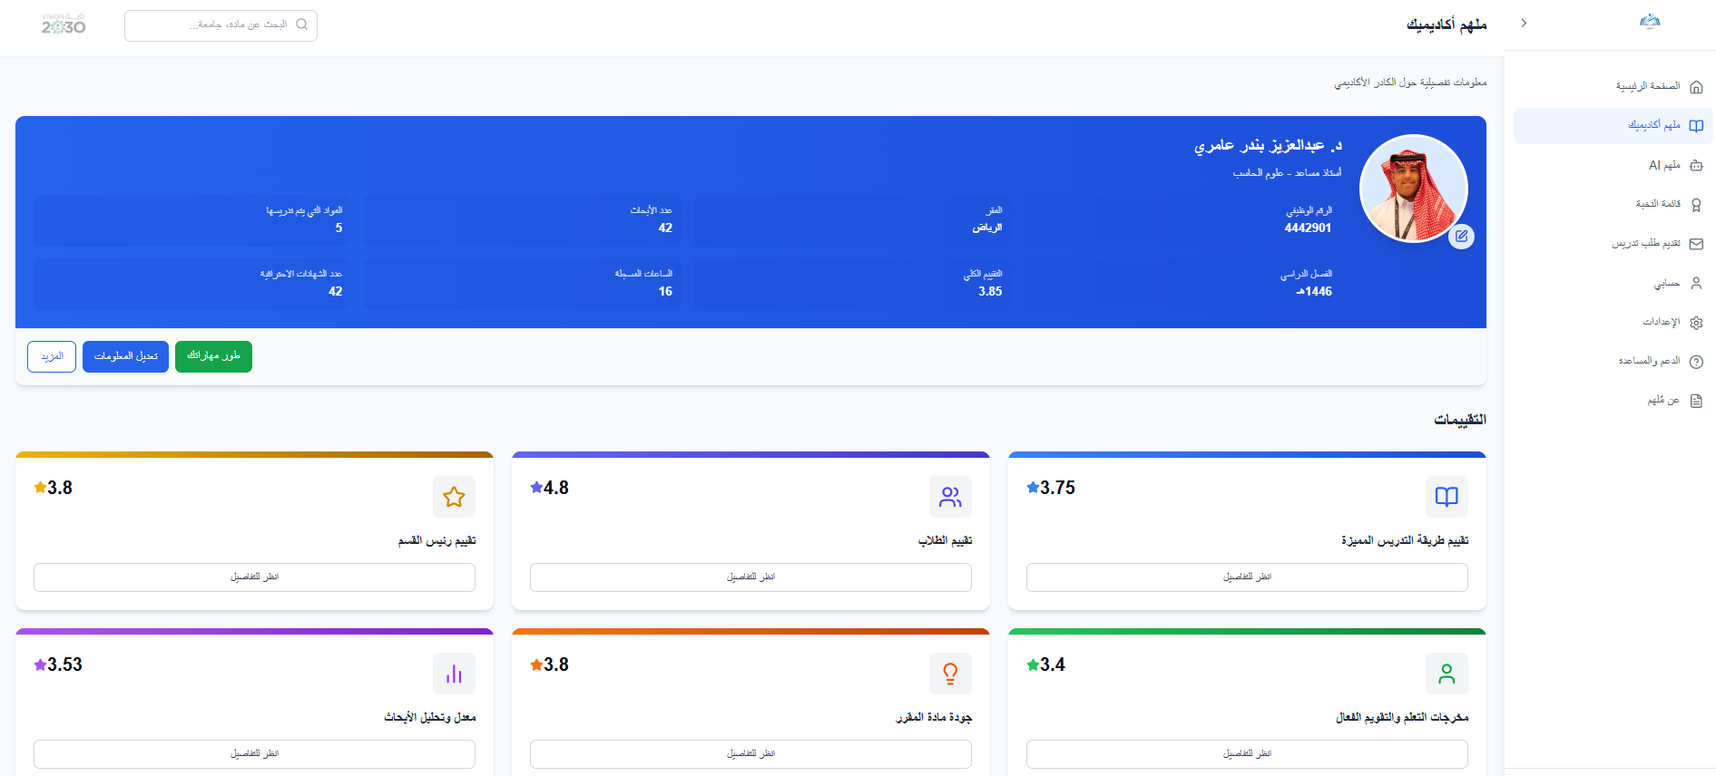
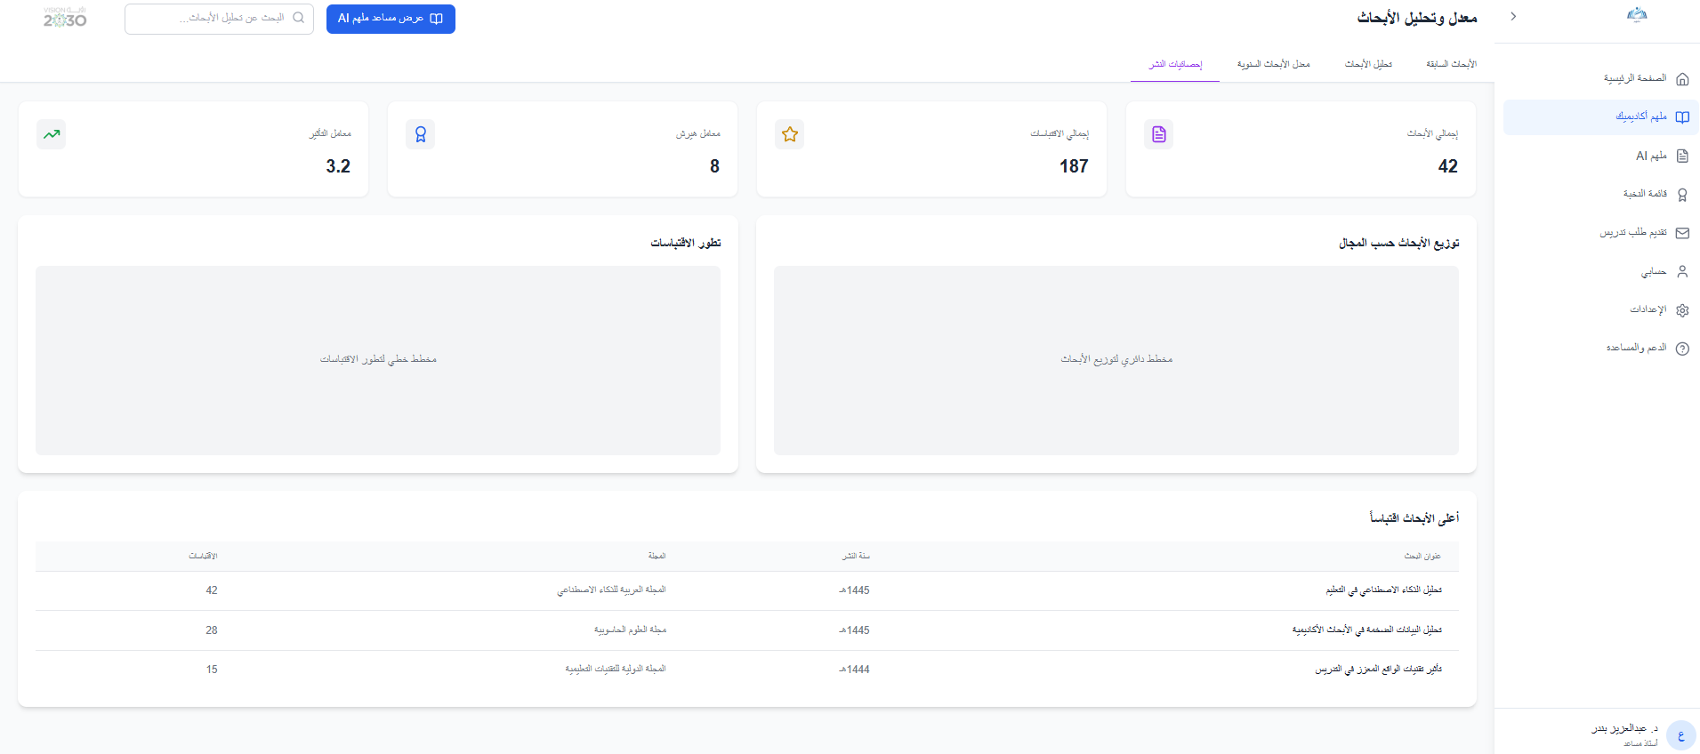
Mulhim: AI for Smart Course Assesment
Hisham Alshref , Musallam Alomair , Salman Smell , Abdulaziz Aamri , Meshal Alssabbah
Department of Computer Science, School of CCIT Shaqra University, KSA
Introduction:
The process of assigning courses to faculty members poses a significant challenge in academic institutions due to reliance on traditional methods, often resulting in poor allocation and misalignment between expertise and course requirements. To address this, Muelhim introduces an AI-powered platform that re-engineers the process scientifically and objectively by analyzing faculty profiles and diagnosing their strengths and weaknesses. When knowledge gaps are identified, the platform provides tailored development plans that include courses, certifications, and up-to-date research resources. Beyond ensuring the right match between faculty and courses, Muelhim builds a roadmap for enhancing teaching and research capabilities. This integrated approach not only improves educational quality and institutional efficiency but also fosters a culture of continuous learning and professional growth.
Methods:
Result:
The development of the Muelhim platform followed a structured, data-centric methodology. First, a comprehensive relational database was designed to aggregate and centralize diverse data, including faculty profiles (specialization, qualifications, years of experience, previously taught courses) and historical student evaluations (both numerical ratings and unstructured textual feedback). The core intelligence of the platform is driven by the implementation of multiple machine learning models: A Random Forest classifier was employed to predict the suitability score of a faculty member for a specific course, using features like specialization alignment and past performance. For deep analysis of qualitative feedback, a Natural Language Processing (NLP) pipeline utilizing the pre-trained AraBERT model was developed to perform sentiment analysis and extract key themes from student comments. Finally, a Hybrid Recommendation Engine was built to provide personalized, actionable suggestions for professional development to faculty members based on their performance patterns. The system was integrated into a user-friendly web interface for seamless interaction.
Result:
The initial pilot phase of the Muelhim platform has demonstrated highly accurate and promising outcomes through its integrated intelligent models. The Faculty Research Analysis Model achieved an accuracy rate of 85% in evaluating the quality of research output and its alignment with faculty specialization, providing clear indicators that support academic promotion decisions and strengthen research excellence. On another front, the Lecture Analysis Model for non-attendance-based sessions reached 80% accuracy in assessing delivery quality, digital engagement, and content organization—directly enhancing e-learning experiences and improving teaching performance. These results highlight Muelhim’s value not only as a course allocation system but as a comprehensive framework for building an accurate profile of academic and research capabilities. With its analytical reports and tailored developmental recommendations, the platform drives institutional efficiency, continuous improvement, and ensures sustained educational quality.
Conclusion:
Building on what has been presented, we aspire for Muelhim to become one of the fundamental pillars in enhancing and improving the quality of course allocation among faculty members, while addressing the gaps that academic staff may face in their assigned courses. The platform’s vision goes beyond ensuring the right match between instructor and course—it aims to foster a comprehensive academic environment that supports research excellence, strengthens teaching efficiency, and delivers continuous development plans to elevate educational standards. Our ambition is for Muelhim to evolve into a global benchmark for re-engineering academic management through AI, serving as a strategic tool that empowers institutions to achieve accreditation, ensure quality, and cultivate a more future-ready academic community.
References:
1- UC Davis
2- Universitat Politècnica de Catalunya (UPC)

